Slide 1
TTU-2 Data Center Analytics and Control Integration of DMTF Redfish API with HPC Tools
Lead faculty: | Yong Chen, TTU
Students: | Ghazanfar Ali, TTU Elham Hojati, TTU Robin Ronson, TTU DheerajKumar, TTU AbhishekKumar, TTU
CAC faculty: | Yong Chen, TTU Alan Sill, TTU
Industry: | Jon Hass, DMTF & Dell Inc. Jeff Hilland, DMTF & HPE
Presenter:
Ghazanfar Ali

Slide 2

Outline
Project Overview
  Goals, Motivation, Challenges
  Team Members
  Background and Related Tasks
Project Status
  Tasks
  Deliverables and Benefits
  Prior Work and Results
  Activities and Outcome
Project Resources and Finances
  Current status
  Plans from now to completion
Conclusions

Slide 3
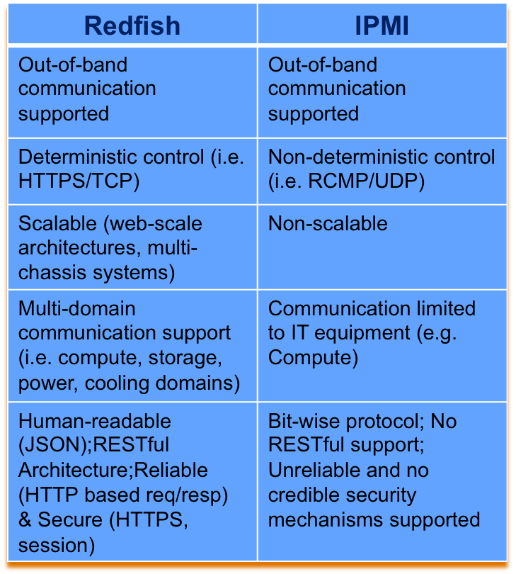


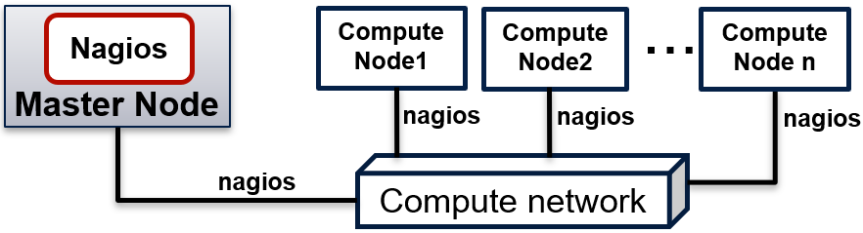
Project Overview
a) HPC infrastructure management using IPMI
Warewulf, Nagios
...
Compute Node1
Compute Node2
Compute Node n
Master Node
IPMI
IPMI
IPMI
Gig Ethernet Switch
IPMI
b) HPC infrastructure management using Redfish
Warewulf, Nagios
...
Compute Node1
Compute Node2
Compute Node n
Master Node
Redfish
Redfish
Redfish
Gig Ethernet Switch
Redfish

Slide 4

Project Goals, Motivation, Challenges
Project Goals
  Promote adoption of DMTF Redfish API in High Performance Computing (HPC) community
  Identify and evaluate HPC tools where Redfish can be adopted
Motivations
  The integration of DMTF Redfish API with HPC will enable:
    HPC tools to leverage latest data center management capabilities of Redfish
    Redfish will act as enabler to perform provisioning and monitoring in a RESTful and deterministic way
Challenges
  Identify areas of HPC operations that are:
    Not yet automated or not yet under control
    Or in which Redfish provides better control and/or potential for automation

Slide 5
Project Team Members
Faculty
  Yong Chen, Associate Professor of CS, Texas Tech University
  Alan Sill, Managing Director of HPCC, Texas Tech University
Students
  Ghazanfar Ali, CS Ph.D. Candidate, Texas Tech University
  Elham Hojati, CS Ph.D. Candidate, Texas Tech University
  Robin Ronson, Undergraduate Student, Texas Tech University
  Dheerajkumar, Masters Student, Texas Tech University
  Abhishek Kumar, Master Student, Texas Tech University
Industry
  Jon Hass, DMTF & Dell Inc.
  Jeff Hilland, DMTF & HPE

Slide 6



Background and Related Research
Identify HPC-oriented tools that use IPMI
Identify areas in which existing tools can be upgraded:
  Bare-metal Provisioning
  Monitoring
Replace IPMI with Redfish in these tools
Examples:
https://openhpc.community
Integrated collection of HPC software components and development tools
Enables Provisioning, Monitoring, and Resource Management
https://www.cloudlab.us
Bare-metal provisioning an ensemble of resources (compute, network, storage)
Network-aware resource placement
https://www.chameleoncloud.org
Provides a reconfigurable computing research instrument for reproducible science.
Reconfigurable bare-metal nodes provisioned via OpenStack Ironic

Slide 7
Task 1: Replacing IPMI with Redfish in OpenHPC Provision
Warewulf is the bare-metal provisioning module of OpenHPC.
  Warewulf can be used as Redfish provisioning server (e.g. firmware update, configuring BIOS settings).
Warewulf
Master Node
Redfish API
Compute Node 1
Compute Node 2
...
Compute Node n
1) Input BMC Credentials for Redfish API
bmc_username="${bmc_username:-Redfish username“
bmc_password="${bmc_password:-Redfish password}"
2) Changing Boot Sequence on Compute Nodes

Slide 8

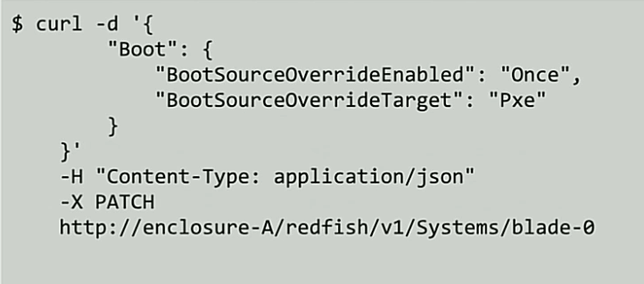
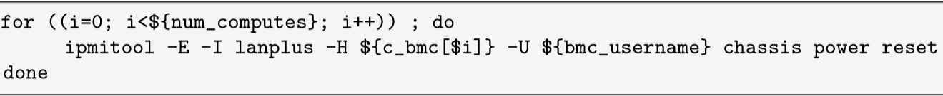
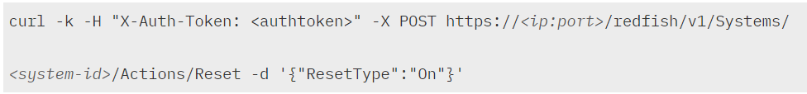
Task 1: Replacing IPMI with Redfish in OpenHPC Provision
2) Changing Boot Sequence on Compute Nodes
3) Boot compute nodes
IPMI
Redfish

Slide 9
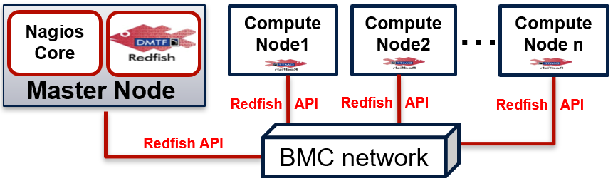
Task 1: Integrating Redfish with Nagios
Nagios Using in-band Communication
Nagios Using out-of-band Communication

Slide 10
Deliverables and benefits
Deliverables
The following Redfish based plugins are developed
https://github.com/nsfcac/Nagios-Redfish-API-Integration
 | Hardware Health Check Plugins
 | Checking Baseboard Management Controller Health
 | Checking Host Health
 | Checking CPU Health
 | Checking Memory Health
 | Checking Fans Health
 | Checking PowerSupplies Health
HPC Infrastructure Health Monitoring using Redfish API and Nagios Core

Slide 11
Deliverables and benefits
Deliverables
The following Redfish based plugins are developed
https://github.com/nsfcac/Nagios-Redfish-API-Integration
 | Hardware Metric Monitoring Plugins
 | Monitoring Power Usage
 | Monitoring CPU Temperature
 | Monitoring Fans Speed
HPC Infrastructure Metrics Monitoring using Redfish API and Nagios Core

Slide 12
Deliverables and benefits
Deliverables
The following Redfish based plugins are developed
https://github.com/nsfcac/Nagios-Redfish-API-Integration
Auto-host discovery to get host information @ Scale
Auto-host configuration for Nagios based monitoring @ Scale

Slide 13
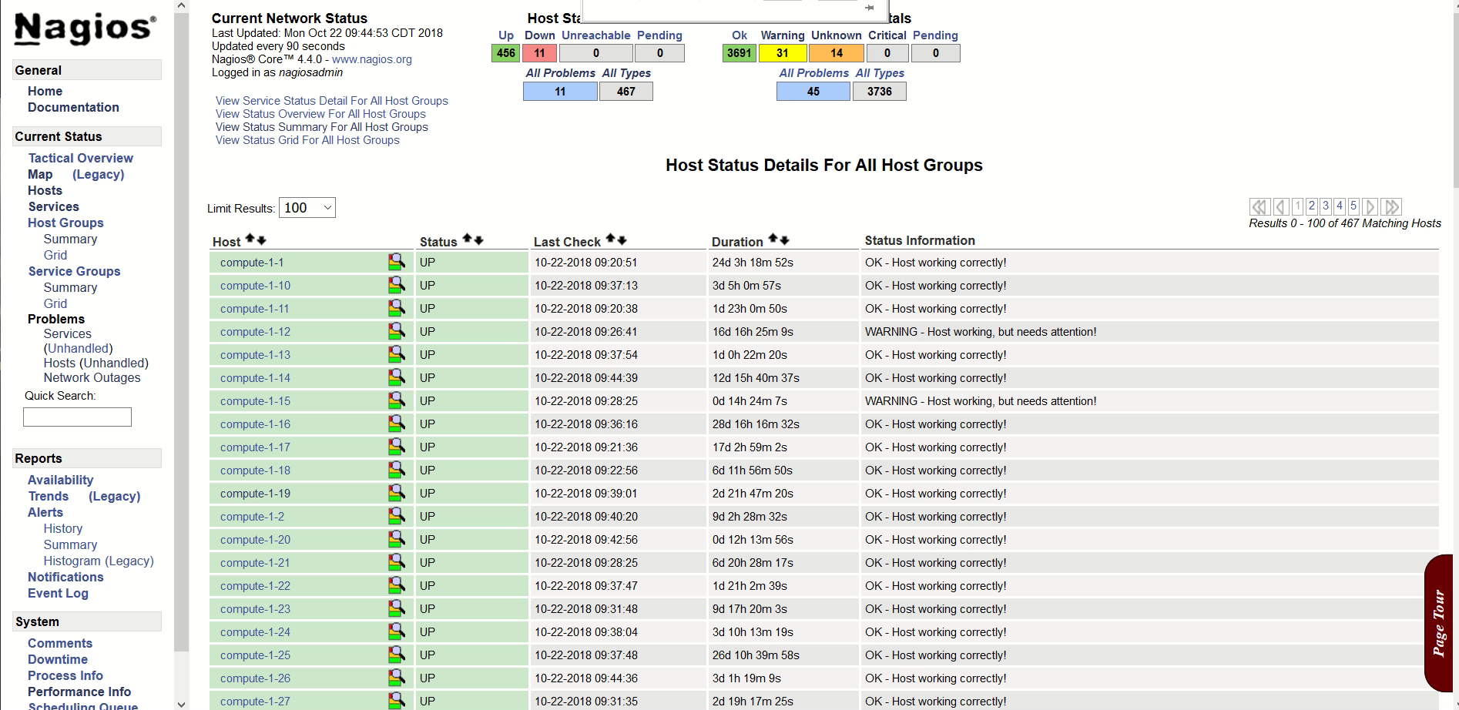
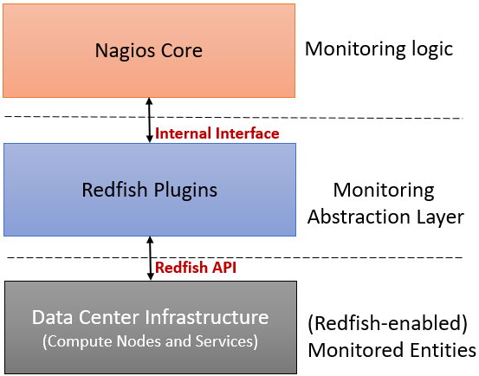

Slide 14
Deliverables and benefits
Benefits
    Network-based auto-discovery & auto-configuration of remote hosts in Nagios core.
    Plugins are hosted on Nagios server & zero installation & configuration is required on remote hosts.
    This integration is potentially a huge paradigm shift in Nagios based monitoring in terms of:
      simplifying communication between Nagios server and monitored hosts
      eliminating computational cost & complexity of running Nagios protocols (NRPE & NSCA) and other agents on the monitored hosts.

Slide 15
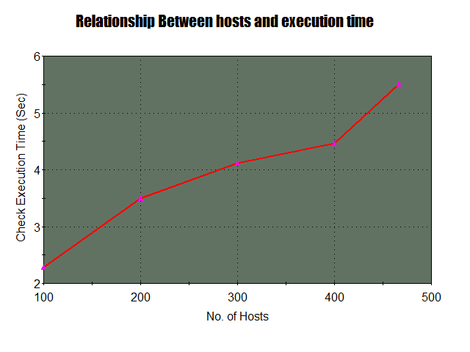
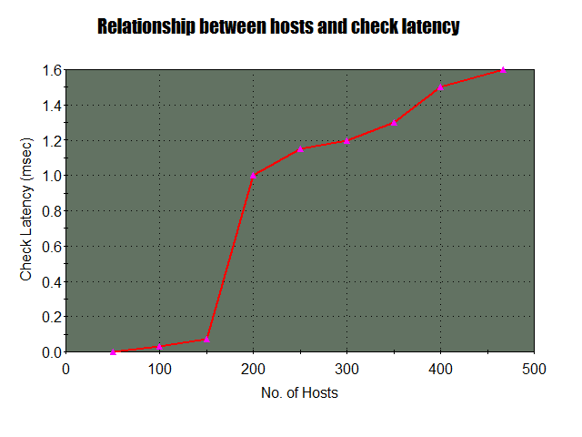
Further Potential List of Tasks
Task1 - Push Based Monitoring and Self-healing of Data Center Using Nagios Core and Redfish API
Task2 - Optimization of Transport Protocol for4Data Center Monitoring
Task3 - Monitoring Power Usage Per-Resource Level
Task4 - Redfish-based Test BMC
Task5 - Data Center Monitoring using Aggregator
Notes:
The Intelligent Platform Management Interface (IPMI)
The most popular platform management which uses for monitoring and controlling the health and functionality of a system in a hardware layer is Intelligent Platform Management Interface (IPMI).
It is supported by more than 200 computer system vendors.
Nowadays, IPMI is a standard for managing hardware of a cluster.

Slide 16
Activities and outcomes
Activities
Redfish API based plugins are developed for Nagios core and tested with Redfish mockup server.
IPMI commands are replaced with corresponding Redfish API call in in OpenHPC based provisioning using Warewulf.
Outcomes
Redfish plugins for Nagios core
https://github.com/nsfcac/Nagios-Redfish-API-Integration
OpenHPC Shell script for replacing IPMI with Redfish

Slide 17
Conclusions
Further improve efficiency of HPC monitoring using Redfish API
Further extend role of Redfish in provisioning and management of HPC infrastructure

Slide 18
LIFE Form Input
Please take a moment to fill out your L.I.F.E. forms.
http://www.iucrc.com
Select “Cloud and Autonomic Computing Center”
then select “IAB” role.
What do you like about this project?
What would you change?
(Please include all relevant feedback.)

